Slide 1
TASSC – Torture Abolition and Survivors Support Coalition
New Restrictions on Work Permits and USCIS Fee Changes

Slide 2
New Restrictions on Work Permits and USCIS Fees Changes
This presentation will be on the new EAD (work permit) regulations only, which are in effect August 25, 2020 and the USCIS fee changes in effect October 2, 2020.
This is not on the new proposed asylum regulations, which are not in effect.
TASSC’s Statement Opposing Proposed Asylum Rules
https://www.tassc.org/news-blog/2020/7/24/tassc-objects-to-proposed-rules-on-asylum

Slide 3
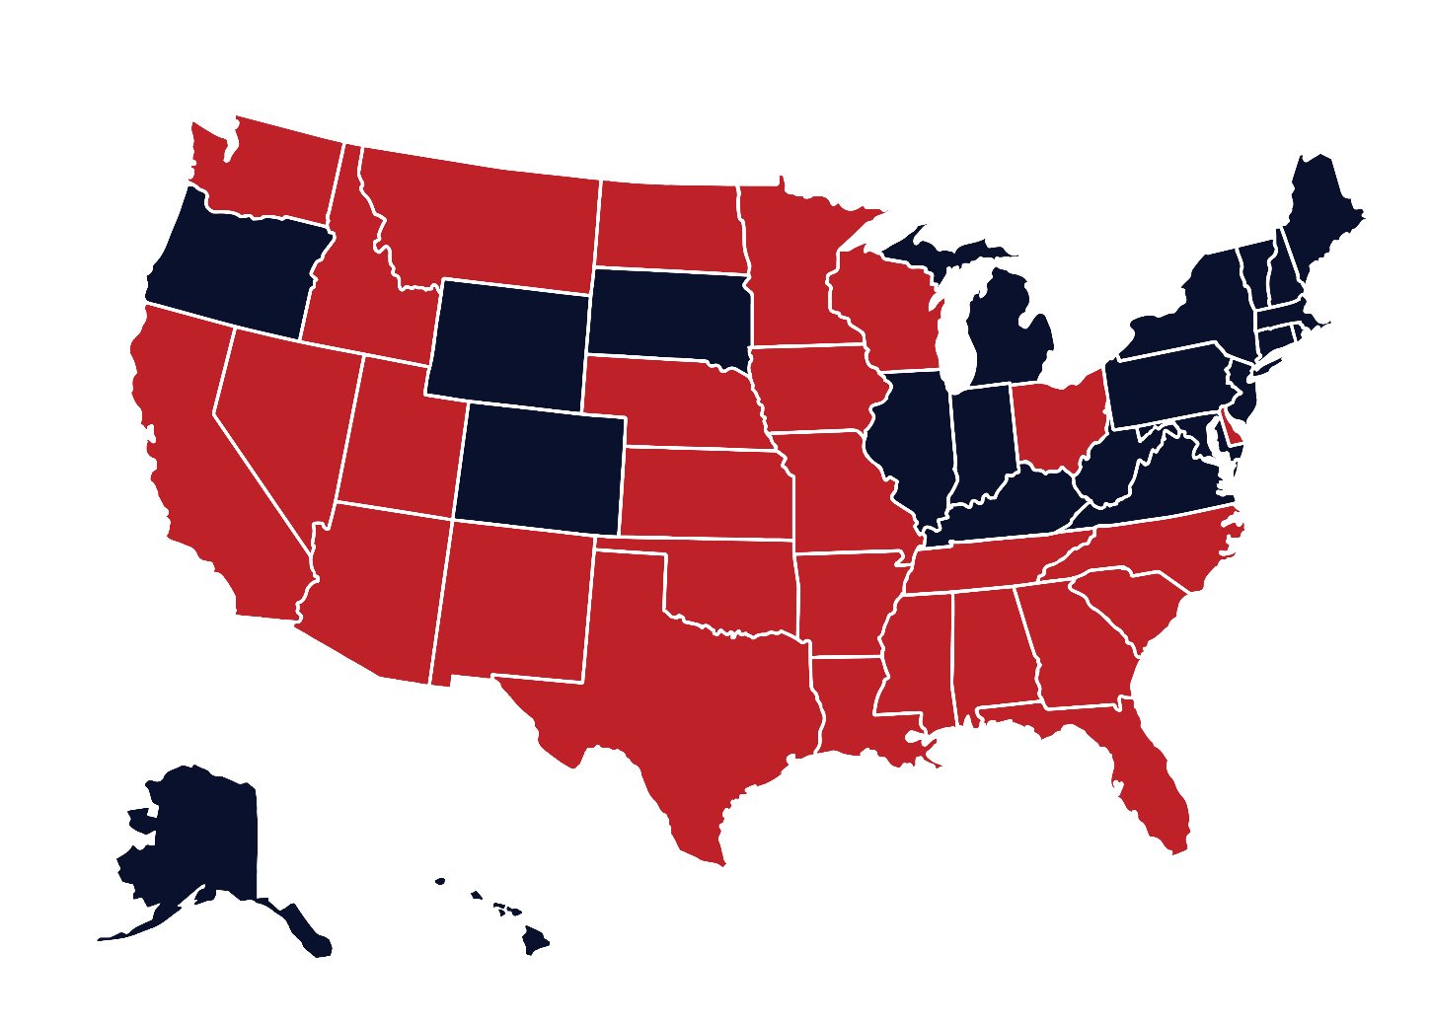
General COVID Updates
DC
DC now requires everyone to wear a mask in the common areas in apartment buildings, as well as in businesses such as shops, offices, and workplaces. Masks are also required outside in public areas and on public transit.
If you live in DC, you must self-quarantine for 14 days after non-essential travel to high risk states.
High risk states do not include Virginia or Maryland.
You may leave your house to get medical care and food.
High risk states are in red.

Slide 4
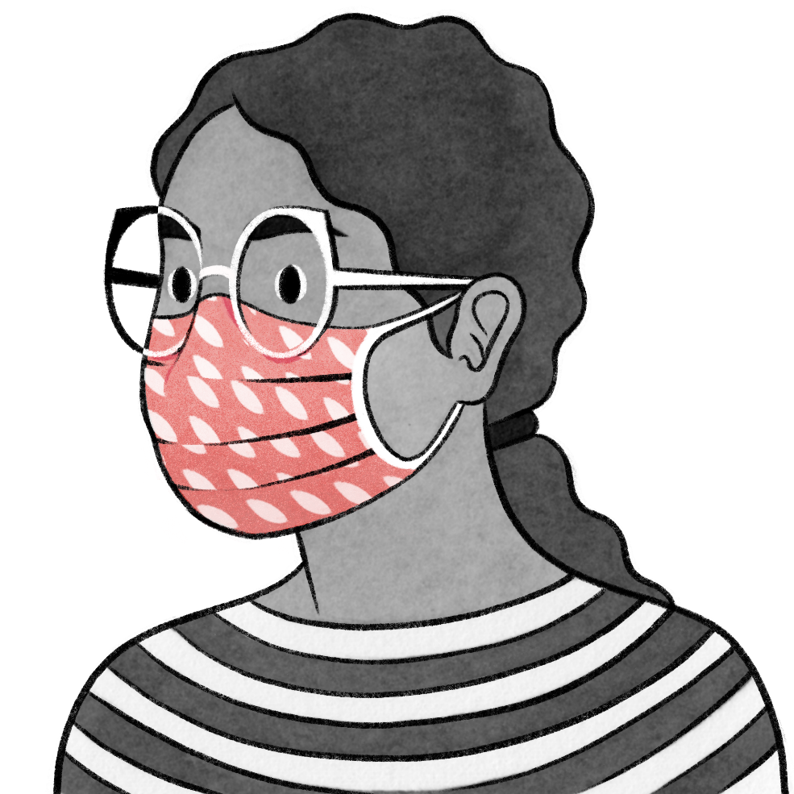
General COVID Updates
Maryland
Masks required in public areas of businesses.
Masks are also required in outdoor areas where it is impossible to socially distance.
Virginia
Masks are required in indoor public spaces and on public transit
Keep 6 feet of physical distance between people when outside
As a reminder, be sure your face mask covers both your nose and mouth.

Slide 5
General COVID Updates
Baltimore
Baltimore Immigration Court is open for non-detained individual hearings only.
Master Calendar hearings are not happening right now. If you have a Master Calendar hearing scheduled, it will probably end up being rescheduled.
Arlington
Arlington is open for both non-detained individual hearings and Master Calendar hearings.
Plan on going to your scheduled hearings

Slide 6
Introduction
I: New Restrictions on Work Permits (Effective August 25, 2020)
What does this rule do?
Who does this rule effect?
What are the exact changes?
II: Bars to Obtaining a Work Permit
One Year Filing Deadline
Manner of Entry
Crime-Related Bars
III. Termination of Employment Authorization
Asylum Office
Immigration Office
If you currently have a work permit
IV. New Fees by USCIS (Effective October 2, 2020)

Slide 7
New Restrictions on Work Permits

Slide 8
New Restrictions on Work Permits
Effective Date: August 25, 2020
What does this rule do?
More than doubles the waiting period to apply for your initial work permit after filing for asylum
Creates additional bars to receiving a work permit
Prohibits work permits for asylum seekers with administratively final asylum denials
Makes work permit approval for asylum seekers optional
Who does this rule impact?
Generally, asylum seekers whose initial or renewal work permit applications are postmarked on or after Aug. 25, 2020
This rule does not effect asylees

Slide 9
What are the changes starting August 25, 2020?

Slide 10
New Restrictions on Work Permits - Changes
Before August 25, 2020
After August 25, 2020
Eligible to apply for an initial work permit 150 days after asylum filing date
Processing time of 30 days
Changes time – now eligible to apply for an initial work permit 365 days after asylum filing date
Initial work permit application can be rejected if any “applicant caused” delays “unresolved” at time of filing
Eliminates processing time; work permits adjudication will likely take longer
If you submitted your asylum application and it was received on or before March 27, 2020, and you have not yet applied for a work permit, apply NOW - postmarked no later than August 24.

Slide 11
New Bars to Work Permits

Slide 12
New Bars to Work Permits Starting August 25, 2020
Bar Based on One Year Filing Deadline (OYFD)
People who miss their one-year filing deadline for their asylum application are barred from applying for a work permit
This does not affect people who missed their OYFD and already applied for their work permit or will apply for asylum before August 25.
Bar Based on Manner of Entry
People who enter or attempt to enter the US between an official port on or after August 25, 2020
Crime Related Bars
Individuals will be ineligible if they are:
Convicted of an aggravated felony
Convicted of a ”particularly serious crime”
Believed to have committed a serious non-political crime

Slide 13
Termination of Employment Authorization

Slide 14
Termination of Employment Authorization
Asylum Office
If Asylum Office denies asylum (person has lawful status) → work permit automatically expires
If Asylum Office refers your case to immigration court (person does not have lawful status) → work permit continues until expiration date
Immigration Court
If the immigration judge denies your asylum and you do not appeal → work permit automatically expires 30 days after the denial
If the immigration judge denies your asylum and you do appeal → your work permit will continue until its expiration date.

Slide 15
Termination of Employment Authorization
If you currently have a work permit:
Asylum applicants will remain authorized to work until the expiration date listed on their work permit.
This new rule will only apply to individuals who file for a work permit on or after August 25, 2020.

Slide 16
New Form Fees by USCIS

Slide 17
New Form Fees by USCIS – Effective October 2, 2020
Form | Current Fee | New Fee
I-589 | $0 | $50
I-765 | $410 | $550
N-400 | $640 | $1,170
I-485 | $1,225 | $1,130
I-730 | No Fee | No Fee
Link to Final Rule:
https://s3.amazonaws.com/public-inspection.federalregister.gov/2020-16389.pdf

Slide 18
New Work Permit Restrictions and USCIS Fees
If you have any questions about these new rules, please check out TASSC’s website at:
https://www.tassc.org/

