Slide 1
TASSC Legal Services Program
Affirmative v. Defensive Asylum
Notes:
Intros of AJ + SK
Presentation Notes: Welcome everyone to... This presentation is intended for current and new TASSC legal services program clients, and also for survivors who are not clients of the LSP, but who want to learn more about the affirmative and defensive asylum process. In our last presentation, we spoke about the how the Legal Services Program operates, how we work with the Social Services and Health and Psychological Wellness programs at TASSC. We also spoke about what is asylum and more about the affirmative asylum process. Today, TASSC LSP Staff Attorney Ashwini Jaisingh and Legal Fellow Shazreh Khan will talk more about the differences between affirmative and defensive asylum, and go into more detail about the process for defensive cases. Finally, we will introduce you to our Advocacy Program and tell you about ways you can participate in advocacy on related issues.

Slide 2
Health & Psychological Wellness
​
Caitlin Tromiczak, LICSW-C, LCSWC
Health and Psychological Wellness Program Manager
Notes:
Caitlin introduction

Slide 3
TASSC COVID Policies
​
TASSC's physical office is closed due to COVID but TASSC staff continue to work from home
TASSC staff have been meeting TASSC survivors over Zoom video and contacting Survivors through phone calls and email
TASSC staff will go into the office to get a client's physical file or mail something for a TASSC survivor as needed but will not meet clients in-person at the office given health & safety concerns
TASSC staff and anyone else who enters the TASSC office is required to wear a mask and disinfect any surfaces they touch
TASSC survivors are discouraged from physically going to the TASSC office and instead should contact staff through email or phone if they have any questions or concerns
Notes:
Shazreh begins

Slide 4
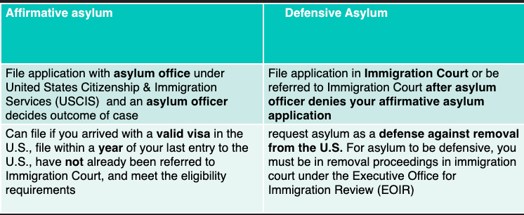
Affirmative vs. Defensive Asylum
​
Notes:
Last presentation we spoke more about what is asylum, how does someone qualify. We went over what the government considers persecution, and that asylum seekers must generally apply within a year of entry, unless there are extraordinary or changed circumstances. Today, we will review in more detail the differences between affirmative and defensive asylum process/

Slide 5
Affirmative Asylum Overview
You can only apply for asylum affirmatively if you entered with a valid visa and are NOT in removal proceedings and an asylum officer has not denied a previous asylum application)
Note: you are still eligible to apply even if your visa has expired
You must submit an I-589 application typically within one year of arrival to the US with a valid visa
There is typically a long period between submitting your application and receiving an interview notice
Shift in scheduling policy January 2018 to "last in first out"
Chance of being called immediately if filing after 2018
Your asylum interview will take place at the Arlington Asylum Office if you live in the DC area
After your interview, expect a long wait for a decision
As of July 15, 2020, 43,000 asylum applications pending with Arlington Asylum Office alone!
​
Notes:
removal proceedings mean you have received a a Notice To Appear/ "NTA" has been served on you
1 year filing exception: extraordinary or changed circumstance exceptions discussed at last orientation
Expect a long delay between filing and the interview notice
it can take months or even years for a decision

Slide 6
Affirmative Asylum Interview
​
An asylum officer determines your eligibility for asylum, evaluates if your answers at the interview are consistent with the application you have submitted, and ultimately assesses your credibility as an asylum seeker
Your attorney of record and an interpreter can be present at the interview
During the interview, your attorney can correct the asylum officer if necessary and make a closing statement for your case at the end of the interview BUT your attorney cannot answer questions on your behalf during an interview
Knowing the information submitted in your asylum application is important so preparing for an asylum interview (preferably with an attorney) is important
TASSC offers mock asylum interviews
mock interview materials can be found at www.tassc.org
Notes:
Attorney of record = who filed a legal representative document known as G-28 on behalf of your asylum case
Important info in your asylum application include dates of key events and country conditions

Slide 7
COVID-19 Asylum Interview Procedure
Masks required
Can only enter Asylum Office 15 minutes prior to interview time
Three separate rooms for asylum officer, attorney, and applicant (can share with derivative family member(s))
Interpreter will be provided telephonically- change from previous policy
Interview conducted with phone audio and video conferencing through Microsoft Teams
Officer will ask applicant to remove mask once in room with door closed
​
Notes:
Asylum office has implemented new procedures since reopening during the pandemic that they have stated will be in place till at least March of next year subject to further notice

Slide 8
Asylum Officer Decision
Officer grants asylum
Asylee status
Asylee Benefits
​
Officer Denies
Case Referred to Immigration Court
Defensive Asylum
Notes:
Hand it off to Ashwini after

Slide 9
Overview of Defensive Asylum
​
Defensive asylum = immigration court proceedings
Asylum is a defense to removal
How does someone get into immigration court proceedings?
Referral to court from asylum office
Seeking asylum at the border
Enter without inspection (not at port of entry) or overstay visa -> ICE apprehension/detention
Loss of other immigration status from a criminal conviction
Notes:
Ashwini picks up
Referral to court—chance to present case in front of an immigration judge, different level of detail and kind of proceeding compared to an asylum interview
Seeking asylum at border- will later explain how this is not currently happening
Enter without inspection- without a visa, and without going through any port of entry. Various ways of entering into ICE custody.
Loss of immigration status from a criminal conviction- possibility of how someone may seek asylum who didn't have to previously

Slide 10
Defensive Asylum: Seeking Asylum at the Border
​
Prior process (currently NOT happening)
Release from Customs and Border Patrol with Notice to Appear (discretionary)
Expedited Removal Proceedings
Anyone apprehended within 100 miles of border and 14 days of crossing
Must express fear of returning to home country
Right to a credible fear interview
Conducted by an asylum officer
"significant possibility" of prevailing in an asylum or other fear-based claim
Right to attorney, but not always possible
With positive determination: enter removal proceedings
possibility for release
Negative determination: removal order, but other options for appeal
Previous deportation order: Reasonable fear interview
"reasonable possibility"--higher burden of proof
Notes:
Please bear with me that this will be an overview, as policies and procedure at the border is complex and could be its own presentation or two. Discussing this as reference as some people watching may have experienced this prior to policy changes currently in effect.
Asylum seekers at border are typically put into expedited removal proceedings.
Expedited removal proceedings= a quicker way for the government to either deport people with less process than "typical" removal proceedings, section 240 INA
CFI- asylum
RFI- withholding or CAT
Negative determination: leads to removal

Slide 11
Previous Process at the Border
​
Policies limiting access to asylum at border
Metering (List keeping in Mexico—dating back to 2018)
Asylum seekers must wait in Mexico until their "number" is called to seek asylum at port of entry—wait times often 6+ months
Migrant Protection Protocols (MPP) Program
Asylum seekers at U.S-Mexico Border must wait in Mexico until their hearing dates
Mainly affected people from Spanish speaking countries
Limited hearings held in tent courts at border, very few people are able to obtain legal representation
Very limited success for people to enter the U.S. and seek asylum
Notes:
We won't go into details into these policies of metering or MPP—organizations that work at the border have been doing tremendous work and have detailed resources. Given the current situation with COVID-19 that I'll describe next—these processes are generally suspended and not happening. We know TASSC members currently in the US and others watching may have been through the metering or MPP process in the past, so we want do want to mention and include that here. Policy had supposed exceptions for vulnerable individuals but we generally heard that was not happening.

Slide 12
Current Process at the Border
​
COVID-19 restrictions currently in effect: Title 42 (Health Code)
Entry at US-Mexico border severely limited since March 20, 2020
Rapid Expulsion Process
No Credible or Reasonable Fear Interview process
Asylum seekers, unaccompanied children, trafficking victims generally all turned away
Limited exception: those who declare fear of torture may be eligible for CAT Protection
Border effectively closed to asylum seekers
Notes:
Rapid Expulsion process: CBP agents will deny anyone seeking to enter before they reach the US.
Will bring people back to the nearest port of entry if from Mexico or Central American Countries immediately, generally within the same day.
Other countries: people will be detained in CBP custody, sent back on airplanes as they are able to fill planes. Depending on the countries, some people may be held longer.
There is no Credible or Reasonable Fear Process—MPP is generally suspended as well, so no opportunity to get a hearing date or any kind of number or "place in line"

Slide 13
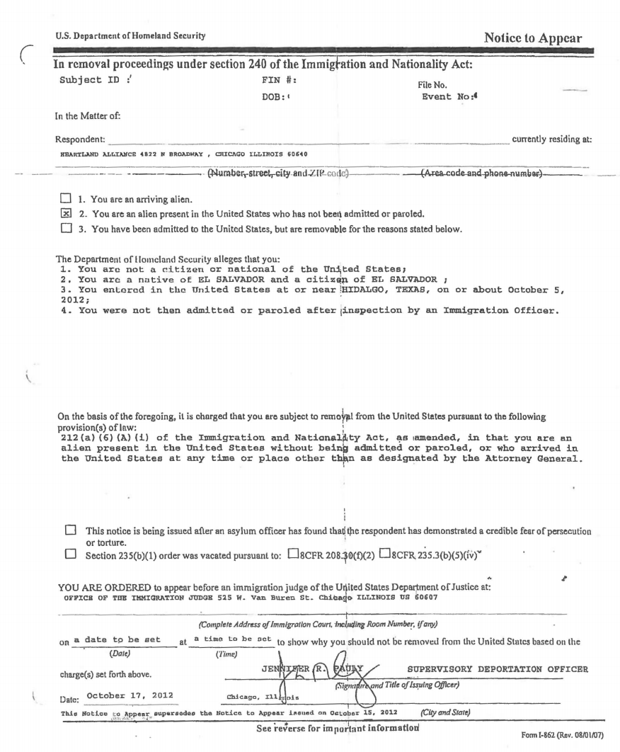
Example of Notice to Appear (NTA)
​
Notes:
Walk through important parts of the NTA such as DHS allegations, provisions of law used, court date/location

Slide 14
How do you apply for asylum?
​
The I-589 form for affirmative and defensive asylum is the same form
Recommend seeking help of an attorney—greater scrutiny on applications
However, if you must apply on your own:
File Form I-589 at Court Window (Recommended) or Mail to Court
Bring 3 copies (1 for Court, 1 for ICE, and 1 for your records to get stamped)
Court clerk (person at window) will stamp that they have received your application with the date
Mail copy to USCIS
Notes:
Previous presentations discuss the requirements for asylum, but a reminder that you typically need to apply within one year of entry unless you have what is called "exceptional" or "changed" circumstances
(INSERT ADDRESS IN SLIDE)

Slide 15
Address to mail a defensive application:
Initial application will start process, it must be complete
In addition to filing defensive Asylum Application With Immigration Court mail to:
USCIS Nebraska Service Center
P.O. Box 87589
Lincoln, NE 68501-7589
Notes:
Previous presentations discuss the requirements for asylum, but a reminder that you typically need to apply within one year of entry unless you have what is called "exceptional" or "changed" circumstances
(INSERT ADDRESS IN SLIDE)

Slide 16
Checking Hearing Date
​
You can call 1-800-898-7180 to get your case status information 24/7 either in English or Spanish or check the website
Website link: https://portal.eoir.justice.gov/InfoSystem
Case status information provided includes hearing date and judge
You need to know your Alien Number ("A" Number) to access your case status
Enter the 9 numerical digits of your "A" number (if your "A" number has only 8 numerical digits then enter number "0" before the 8 digits)
If there are any inconsistencies in hearing dates provided by the hotline and court notices, your legal representation will contact the court for further clarification
Notes:
Pass on to Shazreh

Slide 17
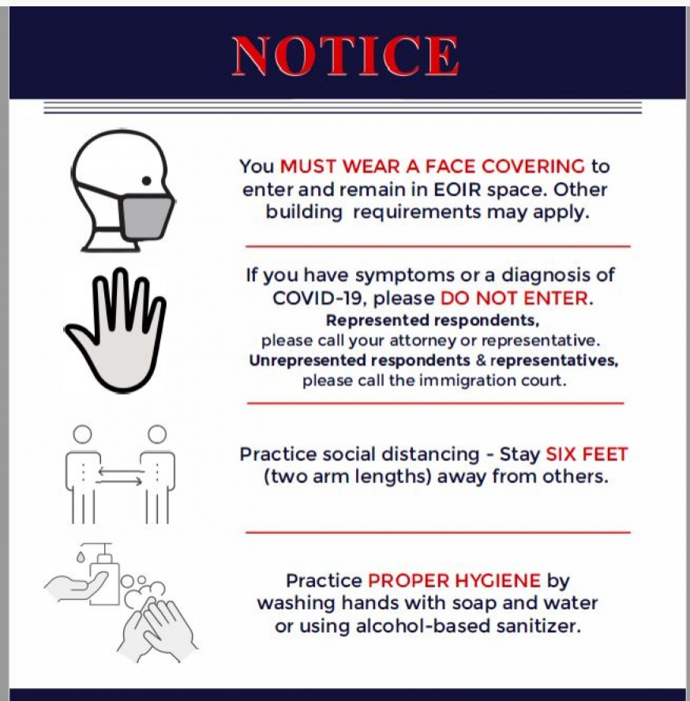
COVID Court Precautions
Notice located on DOJ website: https://www.justice.gov/eoir/public-health-notice
These precautions in the EOIR Public Health Notice are applicable for future individual hearings
Master Calendar hearings are postponed until further notice
​
Notes:
Shazreh: pick it up

Slide 18
Master Calendar Hearings ("MCH")
​
A master calendar hearing is a short status hearing
set the date for your individual or merits hearing
To take pleadings
Admit or deny charges
Conceding removability
Multiple people are called for the same time, and you will be in a room together.
Your attorney may ask preliminary questions to the judge BUT no details of your case will be discussed at a MCH
Due to COVID-19, courts have either conducted MCHs through telephone, delayed MCHs or even entirely cancelled MCHs
Check the court website, call the 1-800 number, or check with your attorney
Notes:
Usual government charges include alleging:
you are here on X visa and you overstayed your visa
Entered without inspection meaning you showed up at port of entry without a visa
You Defend against these charges by applying for asylum

Slide 19
Master Calendar Hearings ("MCH") Cont'd
​
What to Expect:
You will be called up by your A#- 9 digits, on your Notice to Appear
There will NOT be discussion of the details of what happened to you, so you don't have to prepare any statements
The judge will ask your name, address, whether you are comfortable proceeding in English or need an interpreter for your hearing.
If you have an attorney, the judge will confirm their name and the attorney will do most of the talking
If you are unrepresented, the judge will ask if you have received a list of attorneys and you can seek additional time to retain an attorney.
Cases may be scheduled for 3-4 years ahead
Notes:
Depends on what judge you have, some conduct hearings differently, and may have different scheduling availability depending on how many cases they have.

Slide 20
What to do While Waiting for your Individual Hearing: Evidence Preparation and Submission
​
Supplementary filing typically due 2 weeks before individual hearing
Work with LSP to get corroborating documents to add to filing, including:
Statements from friends/family/colleagues who know your experience
Medical/psychological evaluations,
Photos related to harm suffered
Home country government's documents such as arrest warrant, court orders, or summons
You can also work with your attorney to compile evidence about country conditions
LSP attorneys will also prepare a legal brief—overview of your case and evidence
Notes:
Supplementary filing = documents supporting your initial asylum application
Immigration judge has discretion in evidence
Country condition evidence = such as human rights reports, news articles, and country expert reports

Slide 21
Individual/Merits Hearings
​
Typically scheduled years after MCH
Discussion of merits (individual details) of case
An interpreter is appointed by the court
Courtroom setup
In-person: typical court setup with judge at the front of the room, government side to the left and immigrant individual to the right
Telephonic: due to COVID-19, most courts are allowing attorneys to represent client over telephone BUT non-detained clients MUST appear to court in-person
You should discuss with your attorney if they plan on appearing in-person or telephonically before the hearing

Slide 22
Testimony- Direct and Cross-examination
​
Direct= your narrative
Direct is easier because your lawyer will try to establish your credibility and claim for asylum with questions already prepared with you before the hearing
Cross = questioning of your credibility from either the judge or government attorney
Clients can find cross more intimidating because the government attorney is trying to prove your claim is not valid or that you are not credible
Answer truthfully, keep your answers short, and remember to stay calm because the government attorney might try to confuse you
Redirect = opportunity for your lawyer to have you explain your answers to government attorney or judge on cross
Preparation is KEY: Your lawyer will prepare you for both Direct and Cross
Notes:
Made after introductory statements, discussions about evidence, additions
Bulk of the hearing is direct and cross
You may call a witness for your case as can the government
Expert witnesses or fact witnesses (known as lay witnesses)
Typically submit affidavits

Slide 23
Witnesses & Closing Arguments
​
Witnesses- Both the applicant and government can call expert and lay witnesses and usually submit affidavits before testifying
Both your legal representative and government attorney may have the opportunity to provide closing statements
The closing argument is a summary of your asylum claim by your lawyer
The government will also provide a summary of their side arguing why you do not qualify for asylum or should be denied as a matter of discretion
Notes:
Your lawyer will refer to testimony you provided either through direct or cross as well evidence they already submitted to the court to remind the judge of key pieces of evidence to prove your asylum claim

Slide 24
Decision Timing
​
Judge may leave the room and deliver a decision the same day
Alternately, a written decision may be mailed to you and your attorney
A written decision can take weeks, months, or possibly longer during COVID-19!
Remember a written decision does NOT mean the judge is automatically ruling against you
Notes:
Likely judge needs time to write out a decision because of complicated or novel issues in your case
Hand it off to Ashwini after

Slide 25
Immigration Judge Decision & Appeals
​
Immigration Court
If judge grants asylum and DHS does not appeal, then case is over --> Applicant is an Asylee
If judge denies asylum OR judge grants asylum BUT DHS appeals --> appeal must be filed within 30 days of decision to the Board of Immigration Appeals (BIA)
Board of Immigration Appeals (BIA)
If the BIA grants appeal --> asylum is granted or case is sent back to Immigration Court
If BIA denies asylum --> petition for review at the 4th Circuit Court of Appeals (if eligible)
4th Circuit Court of Appeals
If 4th Circuit grant petition--> sends case back to BIA
If 4th Circuit denies petition --> applicant is removed
Notes:
Ashwini pick it up here

Slide 26
Post-Asylum Benefits & Legal Help
​
An asylee (someone who has been granted asylum) can apply within two years to bring their spouse and children to the United States to join them​
​
Unrestricted work authorization, Medicaid, and SNAP (Supplemental Nutrition Assistance Program—food stamps)​, other benefits
Travel—need refugee travel document
IMPORTANT: you cannot travel to the country where you faced persecution
One year after receiving asylum, they can apply to get a green card
should try to keep documentation of your presence in US for adjustment of status—for example: lease, bank records, pay stubs, receipts, affidavits
Five years after receiving asylum, they can apply to become a United States Citizen
Notes:
Paper trail for adjustment of status
If you win asylum but DHS appeals you still have your asylum status but you cannot obtain benefits with the appeal pending until appeal is concluded in your favor

Slide 27
TASSC Advocacy
​
TASSC is actively involved in opposing injustices in the immigration system, including ICE detention and advocating for better policies for asylum seekers.
To get involved with advocacy, contact Andrea Barron, andrea@tassc.org
Notes:
Andrea speaks

Slide 28
Conclusion
For more information on TASSC services please visit:
https://www.tassc.org/

